Slide 1
Lesson 14 -
Grid Example: Get a Row
Mr Mack 2019

Slide 2
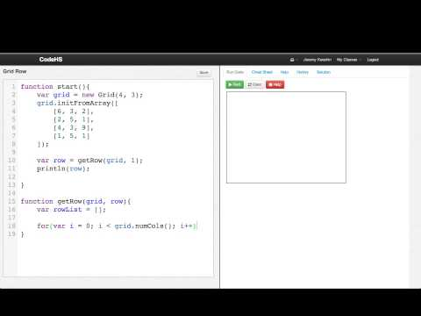
Grid Example: Get a Row

Slide 3
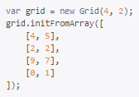
Assume we have a working getRow function and the following grid:
What is the result of calling getRow(grid, 1);?
[4, 5]
[2, 2]
[9, 7]
[0, 1]

Slide 4
Example: Get a Row
This is an example for this lesson. You are encouraged to play around with it, run and change the code, and learn how it works. When you are done, click continue to go to the next problem.

Slide 5
Exercise 5.14.1: Grid Diagonal
Write a function that returns a list of the diagonal elements in a square grid.
function getDiagonal(grid, whichDiagonal)
The diagonals are named by the constants at the top of the program.
var DIAGONAL_TOP_LEFT_BOTTOM_RIGHT = 0;
var DIAGONAL_BOTTOM_LEFT_TOP_RIGHT = 1;
For example, given the grid grid with these contents:
4 2 5
1 8 3
7 3 9
The call
getDiagonal(grid, DIAGONAL_TOP_LEFT_BOTTOM_RIGHT)
Should return an array with contents
[4, 8, 9]
Now test your function by calling it several times, and printing out the grid.

